Slide 1

Project Title - Healthcare Analytics for Doctor Visits
Student Name: Saurabhjyoti Deuri
AICTE STU ID: STU61c4a43749ce51640277047

Slide 2

PROBLEM STATEMENT
Why do some people visit a doctor more often than others?
The dataset shows that people with poorer health visit most, particularly those with reduced activity, frequent illnesses, low health scores, or chronic conditions. Older, female, and lower-income individuals also visit more. Private insurance shows little association with visits, while free-coverage effects vary: freerepat users visit more, whereas freepoor users visit less.

Slide 3
Project Description:
Performed end-to-end EDA in Python on a 5,190-record healthcare dataset to identify factors associated with doctor visits, handling a highly skewed target (80% zeros) through group comparisons and multi-factor checks. Found health status to be the strongest driver of visits, with smaller effects from age, gender and income.

Slide 4

WHO ARE THE END USERS?
Hospital and clinic managers could plan staffing, appointment capacity and outpatient services around the groups that visit most.
Insurance companies could understand how health status and coverage type relate to doctor visits when designing plans.
Public health researchers and epidemiologists could use the results as a starting point for deeper studies, such as the count regression model.
Healthcare data analysts and data science teams could reuse the workflow as a template for analysing skewed, count-type data.

Slide 5

Technology Used
  Google Colab.
  Python
  Libraries used:
      pandas
      NumPy
      matplotlib
      seaborn

Slide 6
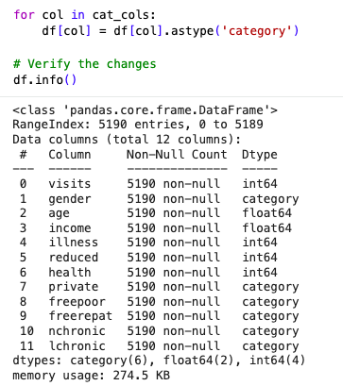
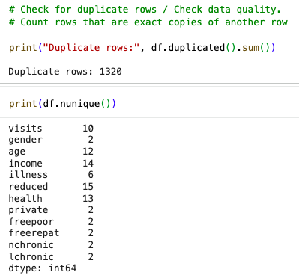
RESULTS

Slide 7
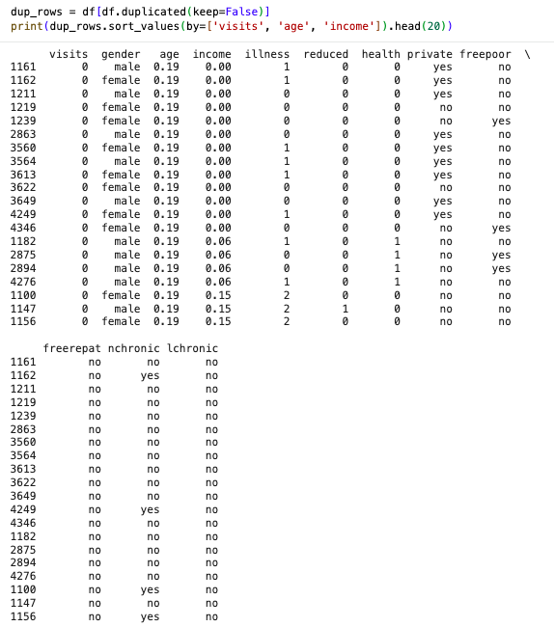
RESULTS

Slide 8
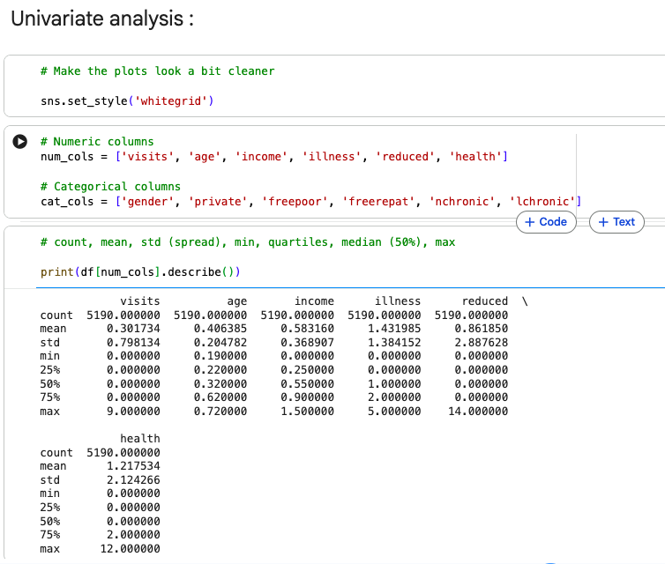
RESULTS
Demo Link

Slide 9
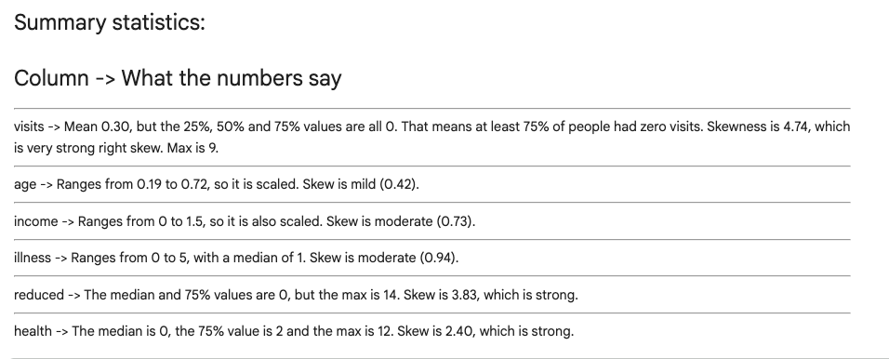
RESULTS
Demo Link

Slide 10
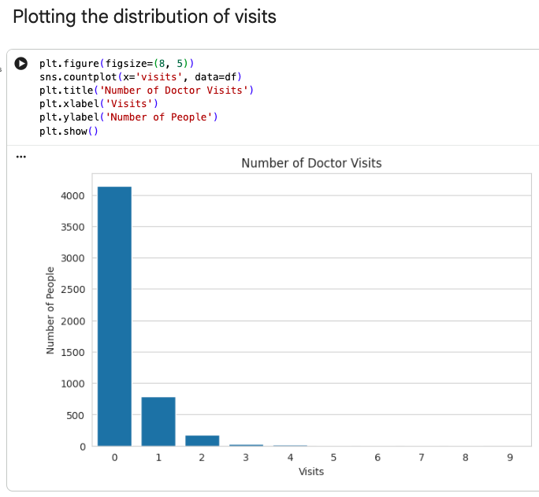
RESULTS

Slide 11
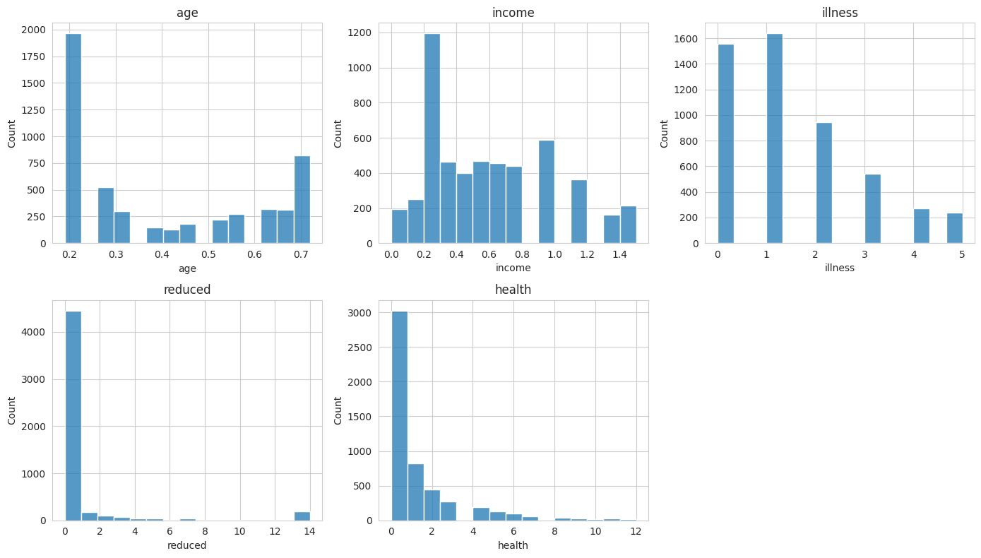
RESULTS

Slide 12
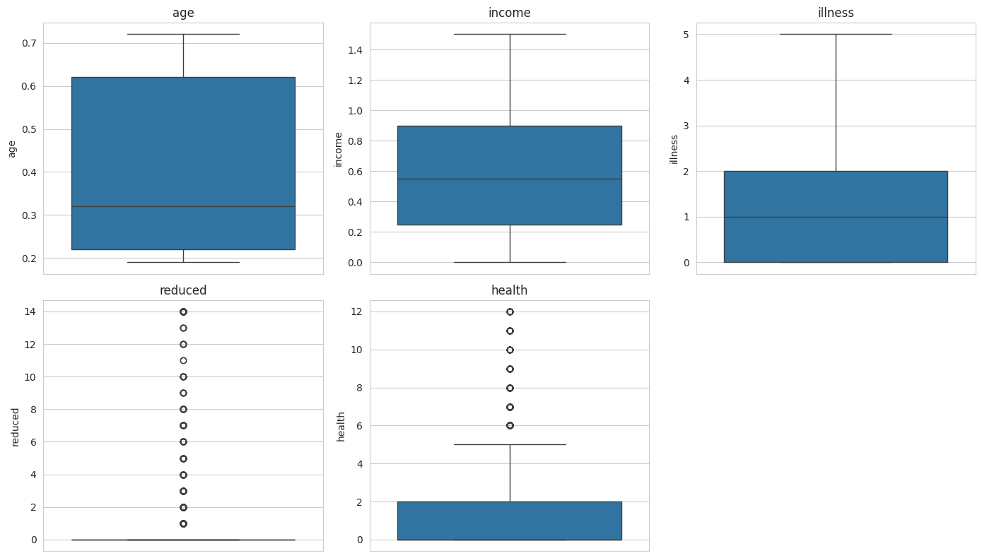
RESULTS

Slide 13
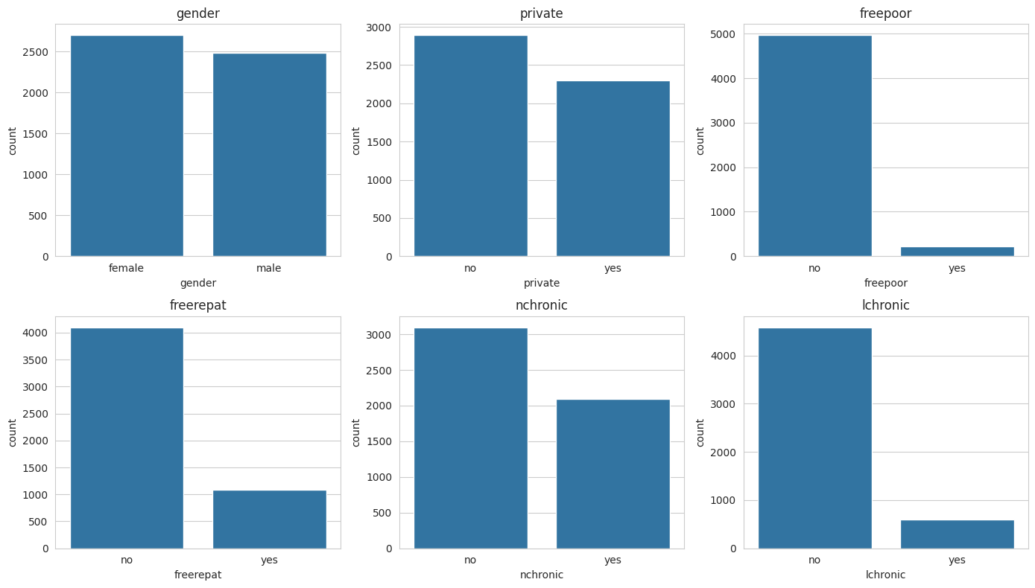
RESULTS

Slide 14
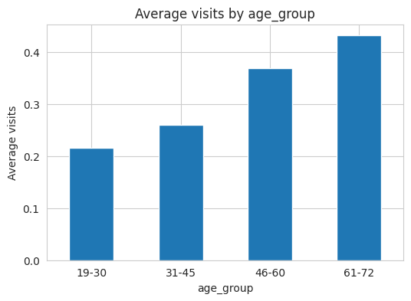
RESULTS

Slide 15
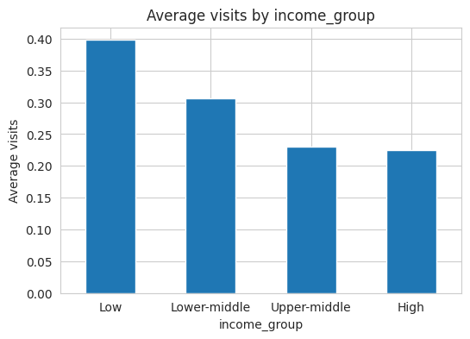
RESULTS

Slide 16
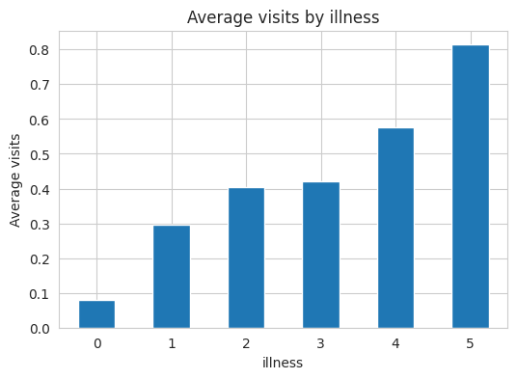
RESULTS

Slide 17
GitHub Link:
https://github.com/saurabhJD/Healthcare-Analytics-for-Doctor-Visits.git

Slide 18
Thank you

